Slide 1
Coaching Agile Teams
Nikitas Kalantjakos

Slide 2
Coaching Agile Teams
Coaching Agile Teams – Lyssa Adkins
A companion for Scrum Masters, Agile Coaches, and Project Managers in Transition
Coaching Agile Teams Workshop
Lyssa Adkins, Michael Spayd
Own experience

Slide 3
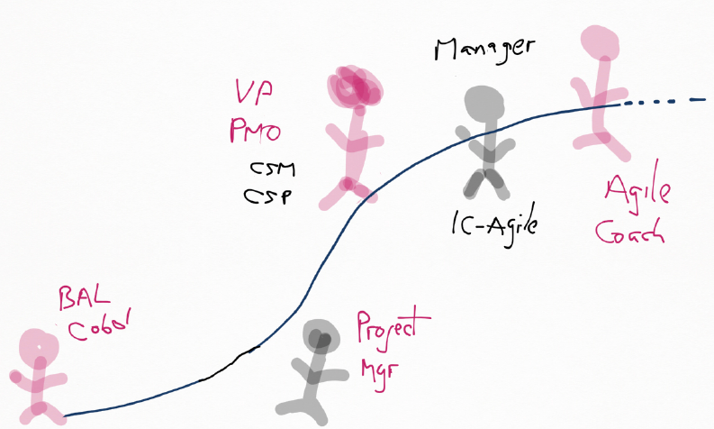
Coaching Journey

Slide 4

Coaching

Slide 5
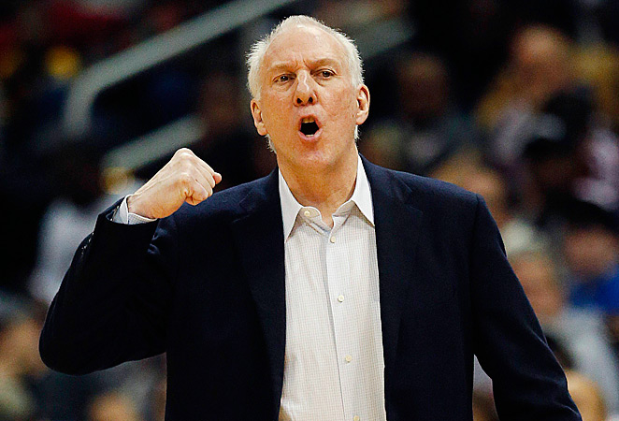
“I don’t do anything!”

Slide 6
Coach
Bulldozer – Remove impediments
Shepherd – Guide back to agile principles
Servant Leader – Serve the team, not you
Performance Guardian – Facilitate high performance
Mission-Driven Leader – Serve the intent

Slide 7
Transform Yourself
Self-Assess First
Detach from outcomes
Take it to the team
Be a mirror
Master your words & face
Let there be silence
Model being outrageous
Let the team fail
Be their biggest fan
Lyssa Adkins

Slide 8
Coaching Goal
Self Sufficiency
Belief System

Slide 9
Agile Coaching Competencies
Agile-Lean Practitioner
Teaching
Coaching
Content Authority
Process Authority
Mentoring
Facilitating
Technical Mastery
Business Mastery
Transformation
Mastery
*Adopted from Agile Coaching Institute
Develop them all!
Let your style change!
Notes:
Let your style flow:
Agile-Lean Practitioner: I get Agile – I’ve done it – I’ve failed & learned
Teaching: I have the knowledge – I am an Agile content authority – Agenda
Mentoring: I’ll walk with you – No agenda – You are the driver
Professional Coaching: I’ll help you figure it out – Powerful questions
Facilitating: I am a collaboration conductor – Ensure the process – Ensure Agile benefits
I need:
Technical Mastery: I get my team’s technical domain
Business Mastery: I exploit the Agile innovation curve
Transformation Mastery: I get organizational development, Agile culture, leadership development and can get you there

Slide 10
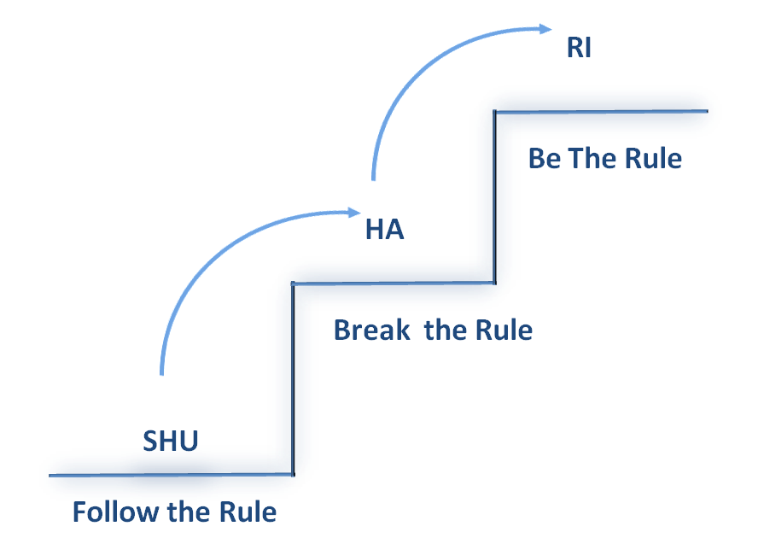
Agile Team Stages
Make It Your Own
Get It
Learn It

Slide 11

From Shu To Ri
Recognize the ‘Edge’
Emerging (Agile)
Familiar
Edge

Slide 12
Agile Coach Failure Modes
Don’t act as a:
Spy
Seagull
Opinionator
Admin
Hub
Butterfly
Expert
Nag

Slide 13
Coach Yourself Out of a Job
“The final act of leading….
Is leaving”.
Kelley Freeman

Slide 14
Coaching Agile Teams Lyssa Adkins
Part I – It Starts with You
Part II – Helping the Team Get More for Themselves
Part III – Getting More for Yourself

Slide 15
